Slide 1

A Study of Distribution Free Non-parametric Regression
B-Tech Project Mid-Term Presentation
Supervisor: Prof. Sivananthan Sampath
Ayush Chaurasia (2016MT10617)
Kumar Prithvi Mishra (2016MT10618)

Slide 2

Contents
Approach
Progress
Why is Non-Parametric Regression Important?
Universal Approximation Theorem
Universality of Deep CNNs
Further Ahead

Slide 3
Approach: A Study of distribution free nonparametric regression
As the name suggests, we will be doing a thorough study or more precisely, a rigorous mathematical analysis of the topics we will be considering under this study.
In general, the topics considered in our study are very popular these days especially in the field of machine learning and henceforth most of the topics are widely used in many of today’s problems.
Our approach to any topic or concept will be to first introduce that concept with some fundamental knowledge and then read recent research papers regarding that.
In this process, we aim to have rigorous mathematical analysis of it and hence reproduce the results with good understanding.

Slide 4
Progress (Work Done)
Firstly, we read two topics namely “Why Is Nonparametric Regression Important” and “How to Construct Nonparametric Regression Estimates” from the book titled same as our project “A Distribution-Free Theory of Nonparametric Regression -By L. Gyœrfi”.
Then after this, we started searching some recent research papers in this field and read their overviews, so that we can decide with which one to proceed. Those papers were mainly of two persons Bernhard Schölkopf & Alexander J. Smola.
After this, we currently are reading about Deep CNNs and their nuances, in the meanwhile we also had to read about shallow networks and will also be reading some other research papers whose results have been cited and used in the Deep CNN paper.

Slide 5
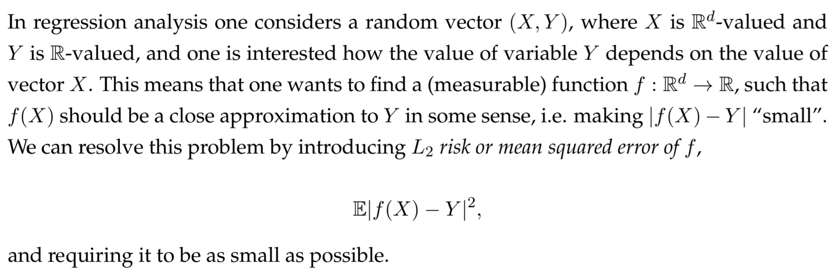
Why is Non-Parametric Regression Important?

Slide 6
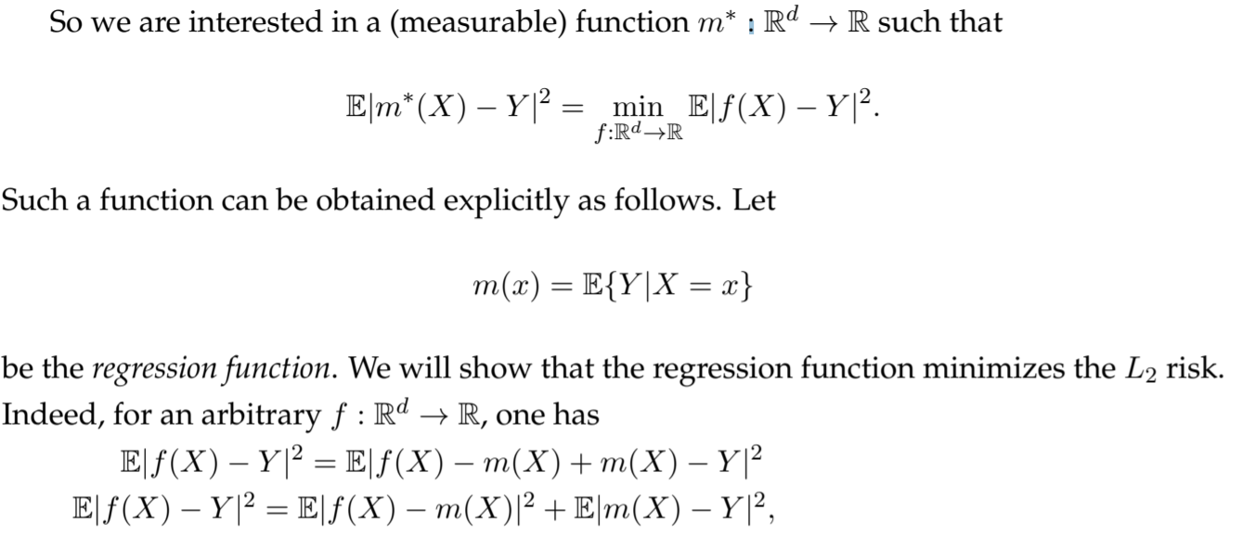

Slide 7
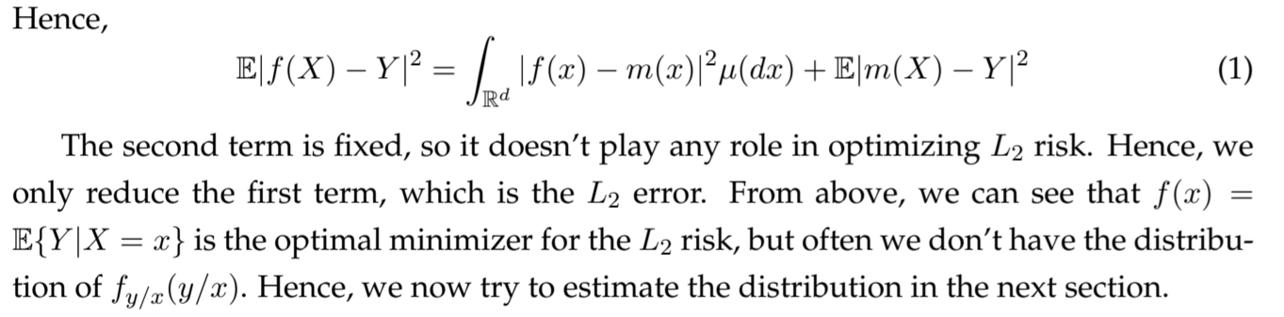
Now two questions arise:
How to make function f(x) for n discrete points ?
How to get the above estimate for f(y/x)?

Slide 8
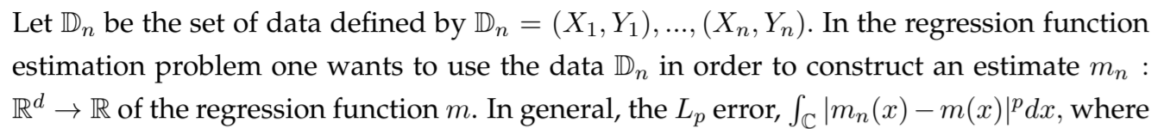
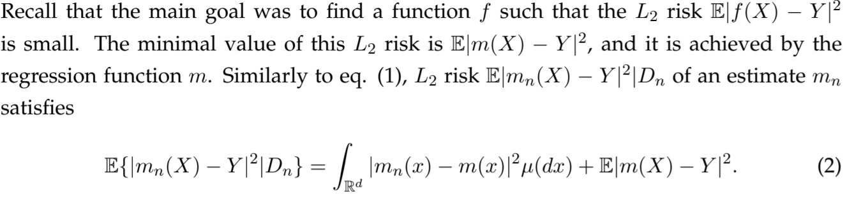

Slide 9
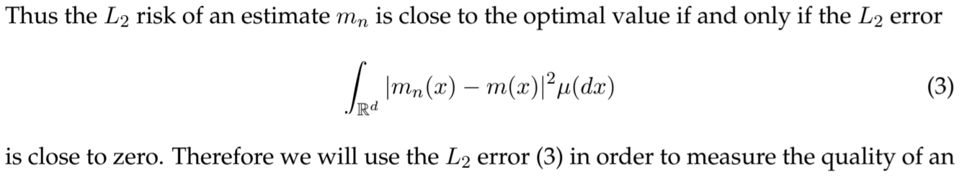
Now we try to generalize the above concept for pattern classification problem as well.

Slide 10
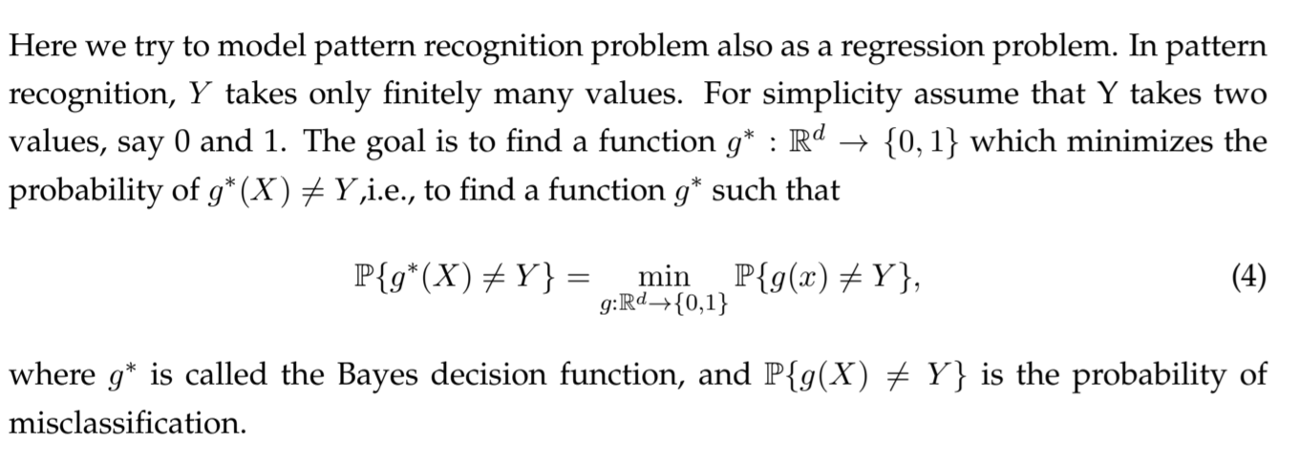
Application to Pattern Recognition

Slide 11
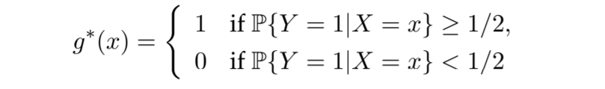
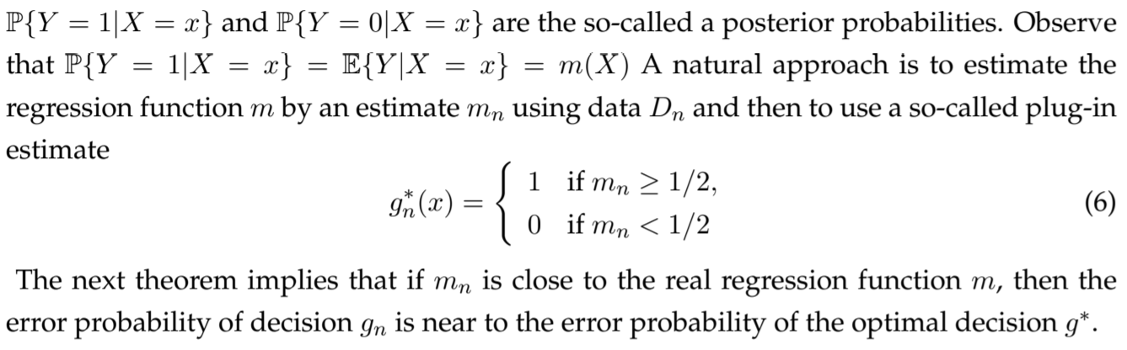

Slide 12
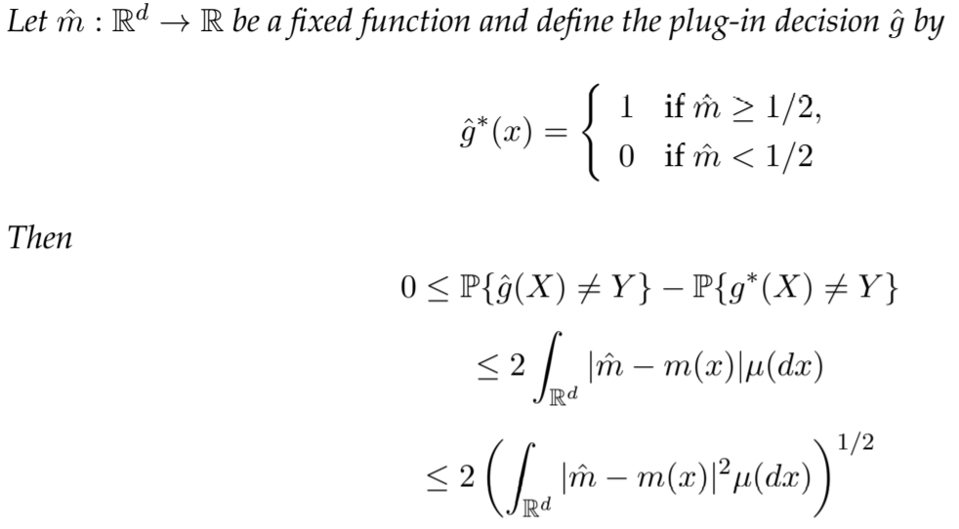
Theorem

Slide 13
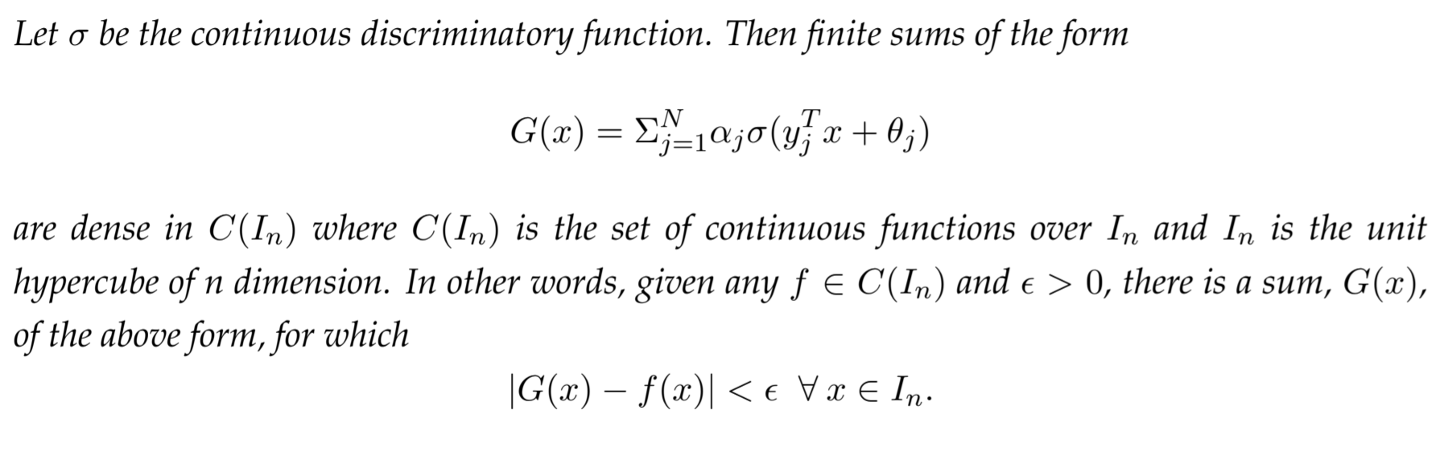
Universal Approximation Theorem (Shallow Network)

Slide 14

Universality of Deep Convolutional Neural Networks
Activation function
Convolutional Filter Masks
Convolutional Neural Networks
Number of parameters in CNN
Hypothesis Space

Slide 15
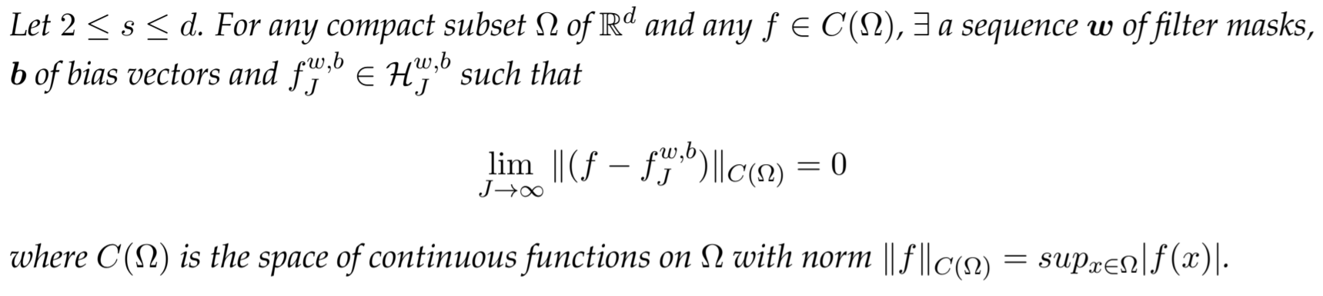
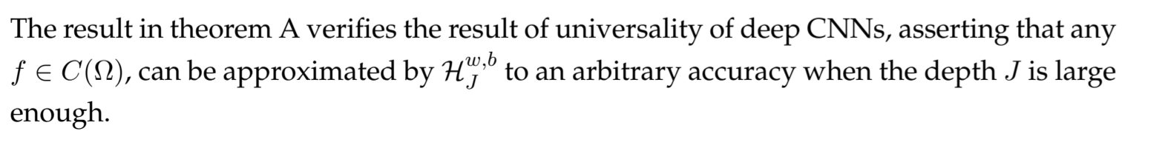
Theorem
Essence

Slide 16
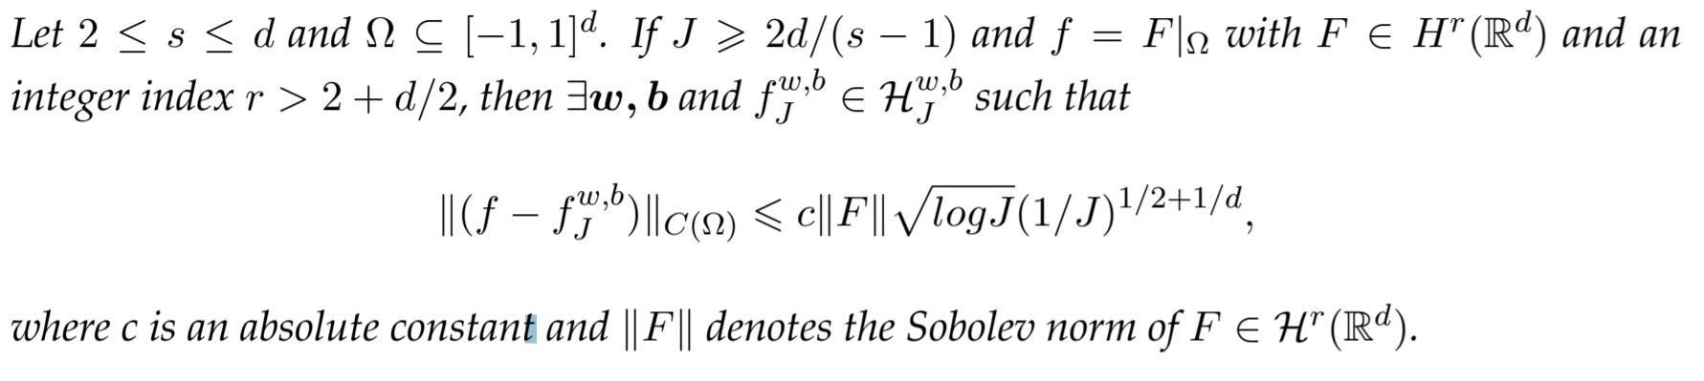
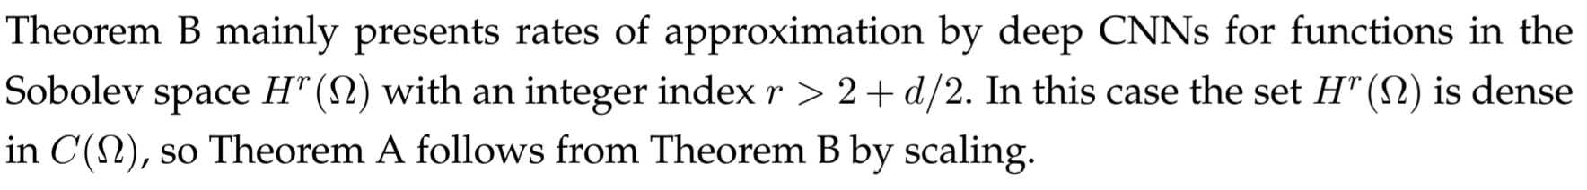
Theorem
Essence

Slide 17
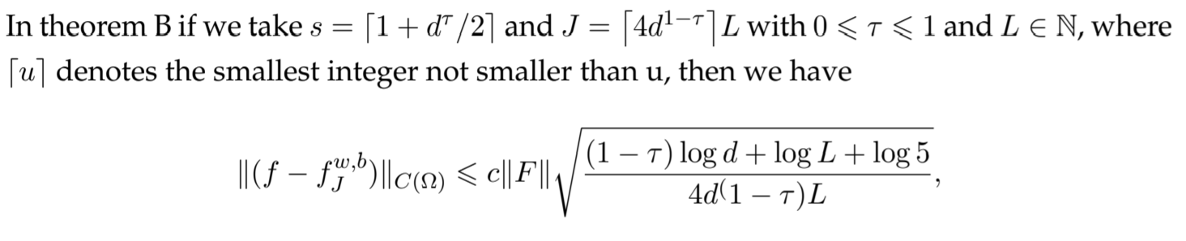
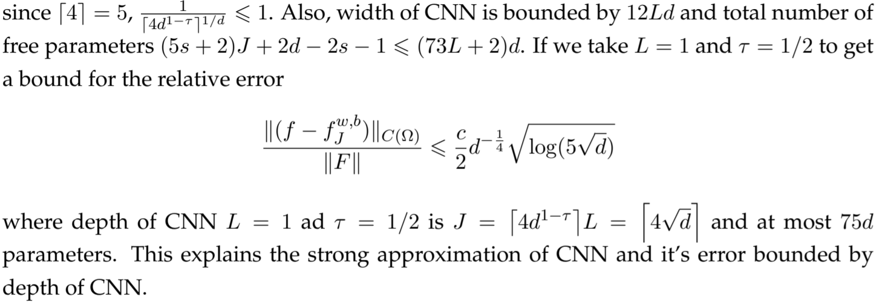
Approximation ability of deep CNNs numerically

Slide 18

Further Ahead
As currently we are doing the CNN paper, we first would like to finish it and after that, many results have been used from different research papers, so we plan to read them.
Secondly, we may also try to explore some other non-parametric methods and read about topics like curse of dimensionality, kernel methods etc.
In this process, we will be considering some recent research papers which solves some present key problem.
Lastly, if time permits we might be able to tackle some practical problem.

Slide 19

Thank You.

